Slide 1

HTTP in Huge Detail From Start to Finish

Slide 2
HTTP Basics
HTTP (HyperText Transfer Protocol)
Text-based client-server protocol for the Internet
For transferring Web resources (HTML files, images, styles, etc.)
Request-response based, relies on URLs
Stateless
Developers who understand HTTP can debug easier!
Just by looking at the network tab!
Understanding the communication will help you understand the web!
You can even optimize the ASP.NET Core technology!

Slide 3
HTTP Request Building blocks
The HTTP Request has multiple building blocks
Request method and URL (with different parts)
Request headers
Request body
The server-side technology reads these and converts them to logic and objects
Routing and action selection
Model binding from query string and body
And some other operations behind the scenes

Slide 4
GET request example
GET /users/ivaylokenov HTTP/1.1
Host: api.github.com
Accept: */*
Accept-Language: en
Accept-Encoding: gzip, deflate
User-Agent: Mozilla/5.0 (Windows NT 10.0; WOW64) AppleWebKit/537.36 (KHTML, like Gecko) Chrome/54.0.2840.71 Safari/537.36
Connection: keep-alive
Cache-Control: no-cache
<CRLF>

Slide 5
POST request JSON example
POST /post HTTP/1.1
Host: postman-echo.com Accept: */*
Accept-Encoding: gzip, deflate
Content-Type: application/json
Connection: keep-alive Content-Length: 95
<CRLF>
{"title":"Found a bug","body":"I'm having a problem with this.","labels":["bug","minor"]}
<CRLF>

Slide 6
POST request FORM example
<form method="post">
Name: <input type="text" name="name"/> <br/>
Age: <input type="text" name="age"/> <br/>
<input type="submit" />
</form>
POST /index.html HTTP/1.1
Host: localhost
Content-Type: application/x-www-form-urlencoded
Content-Length: 23
name=Maria+Smith&age=19

Slide 7
HTTP response Building blocks
The HTTP Response has multiple building blocks
Response status and URL
Response headers
Response body
The browser and the JavaScript read these and convert them to logic and objects
Visualization on the screen with HTML & CSS
Logic and data manipulation with JavaScript
And some other operations behind the scenes

Slide 8
HTTP Response example
HTTP/1.1 200 OK
Date: Fri, 11 Nov 2016 16:09:18 GMT+2
Server: Apache/2.2.14 (Linux)
Accept-Ranges: bytes
Content-Length: 84
Content-Type: text/html
<CRLF>
<html>
<head><title>Test</title></head>
<body>Test HTML page.</body>
</html>

Slide 9
HTTP Headers
The HTTP headers add more information to the communication
It is the data that the user does not see
The server and the client "control" what is possible and what is not
As a developer, you can look at the headers to understand why a request/response is not working correctly
You can also add additional headers to force certain functionality

Slide 10
HTTP Headers - capabilities
HTTP Access Control (CORS)
HTTP Authentication
HTTP Caching
HTTP Conditional Requests
HTTP Compression
HTTP Content Negotiation
HTTP Range Requests
HTTP Redirects
HTTP Cookies

Slide 11
Access Control (CORS)
Multiple headers for access control
Access-Control-Allow-Headers
Access-Control-Allow-Methods
Access-Control-Allow-Origin
In ASP.NET Core – the CORS middleware
Access-Control-Allow-Origin: *
Access-Control-Allow-Origin: https://codeitup.today

Slide 12
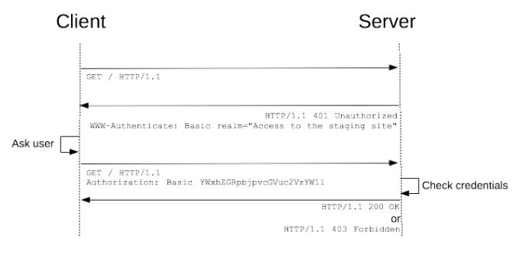
Authentication
Different kind of authentication protocols are available
The most common is the Bearer (the Jwt package for ASP.NET Core)
Authorization: Bearer <token>

Slide 13
Caching
The Cache-Control header allows us to store the server response
Public – the data is shared
Private – the data is for the current user only
The cache can be revalidated, if the user presses the reload button
Or if the cache has "must-revalidate" directive
Cache-Control: private
Cache-Control: public, max-age=<seconds>

Slide 14
Caching
Revalidation can be done by adding one of the following headers
ETag – a unique identifier representing the resource
Last-Modified – the data is checked against a date
The Vary header can be added to distinguish different responses from the same resource
In ASP.NET Core - the Response Cache middleware and action filter
Vary: User-Agent

Slide 15
Conditional Requests
These requests are executed differently, based on the headers
The headers define a precondition, and the result will be based on whether the precondition was matched or not
Used with ETag and Last-Modified
If-Match
If-None-Match
If-Modified-Since
If-Unmodified-Since
In ASP.NET Core – used by the Static Files middleware

Slide 16
Compression
File compression
Lossless – PNG, for example
Lossy – JPEG, for example
Content compression with the Accept-Encoding and Content-Encoding headers
In ASP.NET Core – the Response Compression middleware
Accept-Encoding: deflate, gzip;q=1.0, *;q=0.5
Content-Encoding: gzip

Slide 17
Content Negotiation
The Accept header defines what the client understands as media types
The Content-Type header defines what is the data in the body
In ASP.NET Core – the model binding mechanism
Accept: text/html, application/xhtml+xml, application/xml;q=0.9, image/webp, */*;q=0.8
Content-Type: text/html; charset=UTF-8
Content-Type: application/json

Slide 18
Content Negotiation
The Content-Disposition header controls how the browser renders the response
Standard media types: https://www.iana.org/assignments/media-types/media-types.xhtml
Content-Disposition: inline
Content-Disposition: attachment
Content-Disposition: attachment; filename="filename.jpg"

Slide 19
Range requests
Range requests allow bigger resources to be transferred in chunks
For example - lengthy videos
If a response have the Accept-Ranges header:
Then the client can request partial requests with the Range header:
The File result in ASP.NET Core supports partial request
Accept-Ranges: bytes
Range: bytes=0-1023

Slide 20
Redirects
Two types of redirects:
Permanent – the browser never tries to access the original site again
Temporary – the browser tries to access the original site every time
Based on the Location header:
The Redirect results in ASP.NET Core support this concept
Location: http://mynewwebsite.com

Slide 21
COOKIES
The HTTP Cookies have multiple use cases
Session management
Personalization
Tracking
The Cookies are created by the Set-Cookie header (for a domain)
The Cookies are sent by the Cookie header
ASP.NET Core support Cookies through the HttpContext object
Set-Cookie: id=a3fWa; Expires=Thu, 21 Oct 2021 07:28:00 GMT; Secure; HttpOnly

Slide 22
Other headers
Some other headers:
Referer - contains the address of the page making the request
Forwarded - contains information from the reverse proxy servers that is altered
X-Forwarded-For - header for identifying the originating IP address of a client connecting to a web server, useful with proxies
User-Agent - characteristic string that lets servers and network peers identify who makes the request

Slide 23
ANY QUESTIONS?

